Slide 1
Creating a CMS simulation
Load Bathymetry Scatterset/SMS Project
Develop Grid Domain
Activity Dataset (Land/Water)
Build Quadtree or Cartesian grid frame
Boundary Conditions

Slide 2
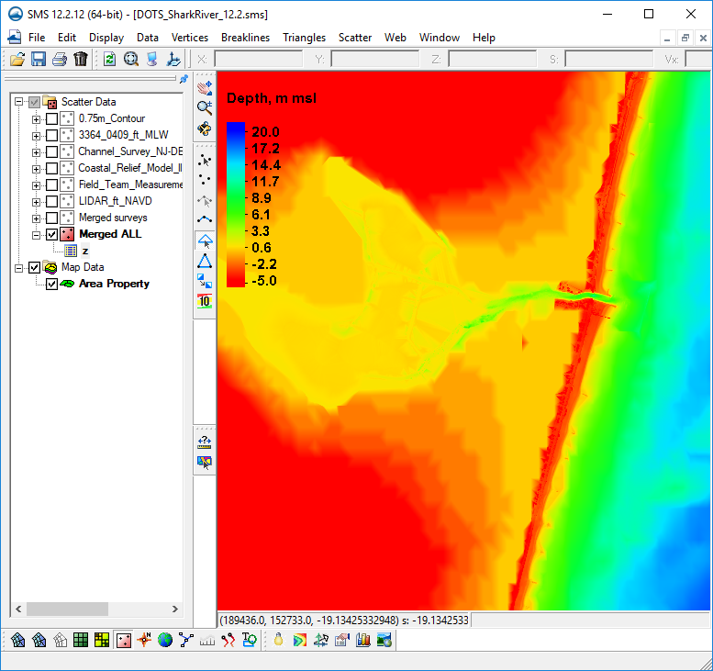
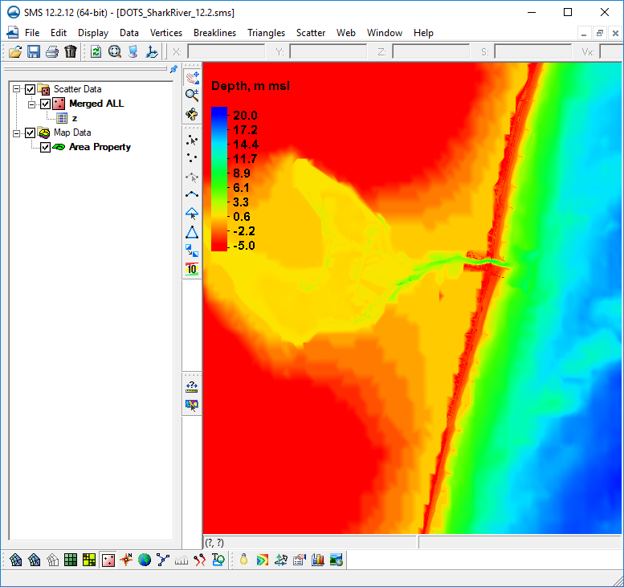
Old survey datasets in project are not necessary once the final merged bathymetry is set. Others can be removed from project.

Slide 3
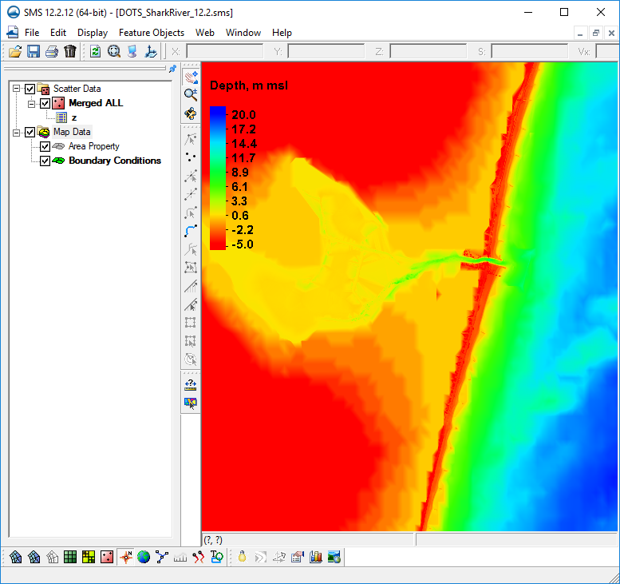
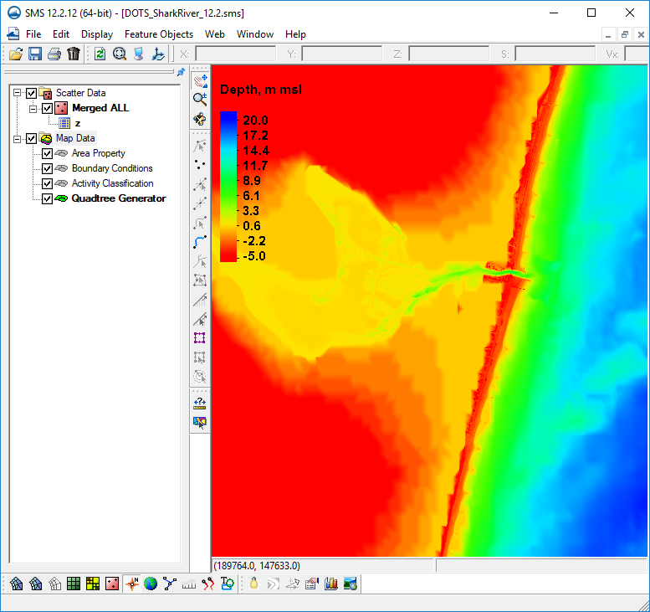
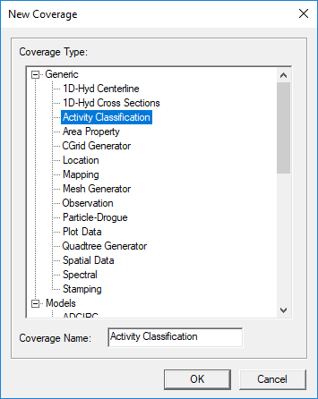
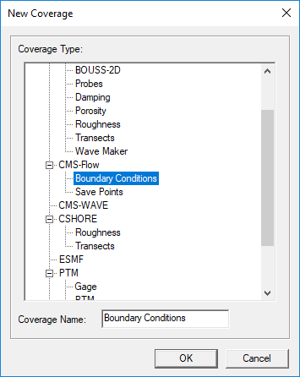
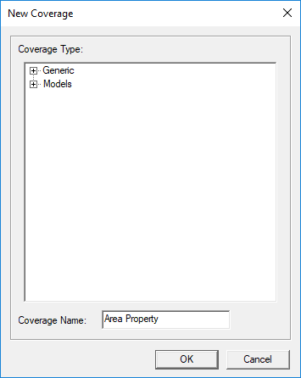
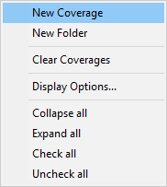
Add New Coverages for CMS
Models | CMS-Flow | Boundary Conditions
Generic | Activity Classification
Depending on whether you want to use a Quadtree or Cartesian grid, choose one of the following:
Generic | Quadtree Generator
Generic | CGrid Generator

Slide 4
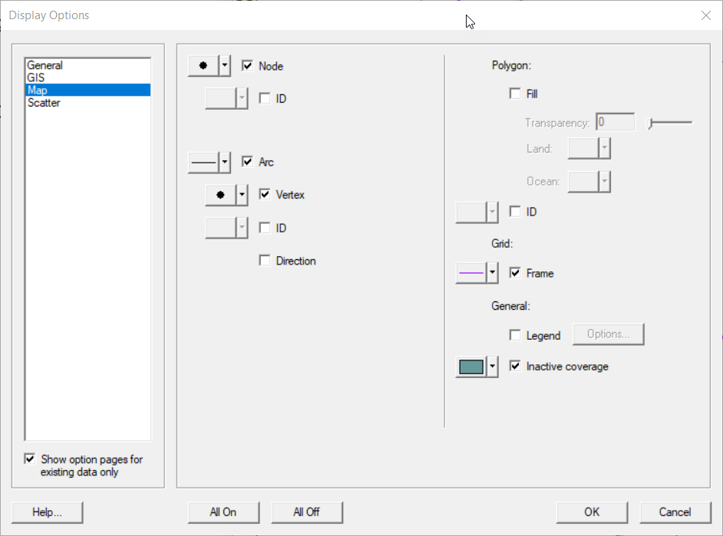
Since there are several coverages that will be used from the Map Module, we will want to see some of the information from other coverages while we work on some others.
To enable this, choose Display | Display Options
Click Map from the options on the left, then place a check in the box named “Inactive coverage” from the options on the right.

Slide 5
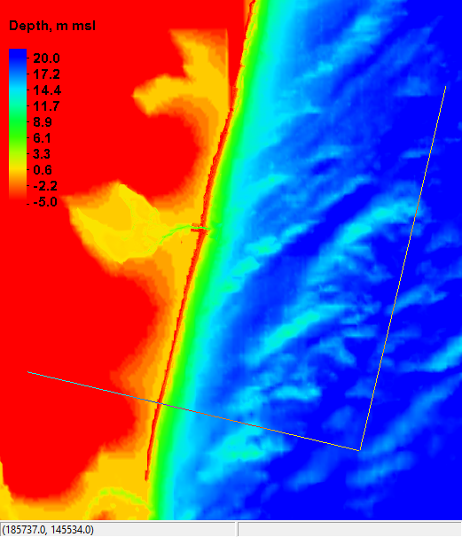
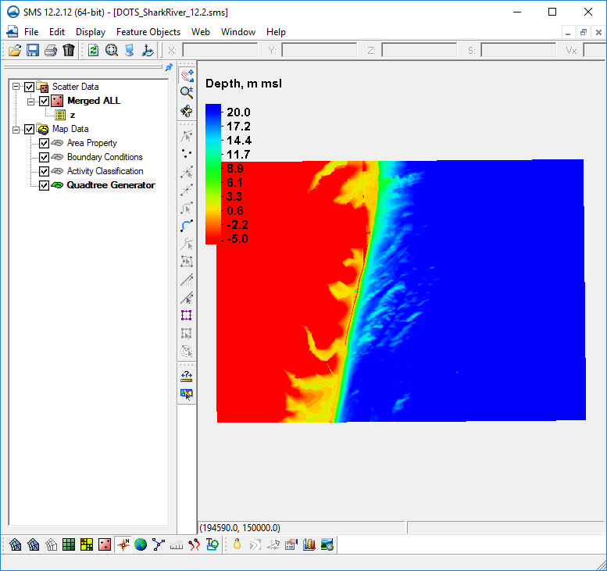
Select Quadtree/CGrid Generator Coverage
Select Create Grid Frame tool
3
Define domain of CMS grid by clicking three points (order or extreme accuracy is not necessary)
Grid Frame is built but may be partially hidden from view by filled display contours.
Making contours semi-transparent can help.
1
2

Slide 6
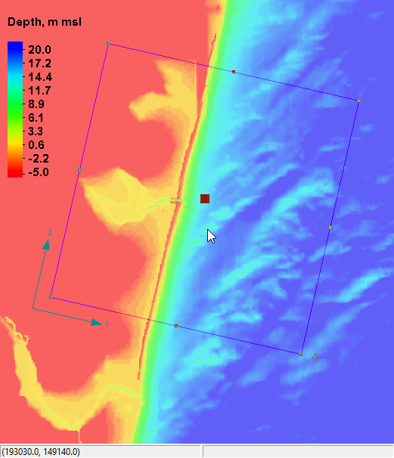
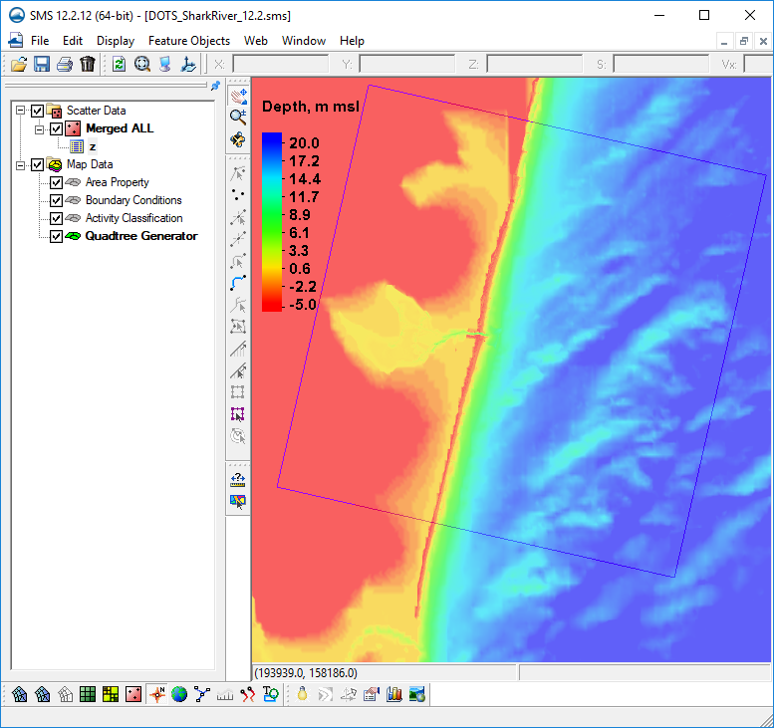
Click Select Grid Frame tool
Click frame selector
You can now resize with corner or edge center points
You can rotate around IJ Axis with handle
Make sure to SAVE frequently as you go along.

Slide 7
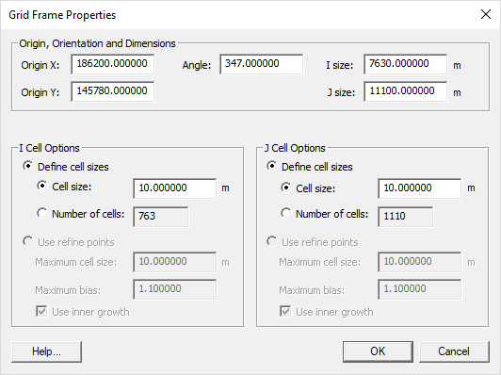
Double Clicking the Grid Frame selector will bring up a property dialog.
After experimenting with the handles and rotating, enter the values as shown in the top section only.
This defines the exact origin, I and J extents and rotation angle to our desired area.
We will come back later to add resolution for telescoping or Cartesian grids.

Slide 8
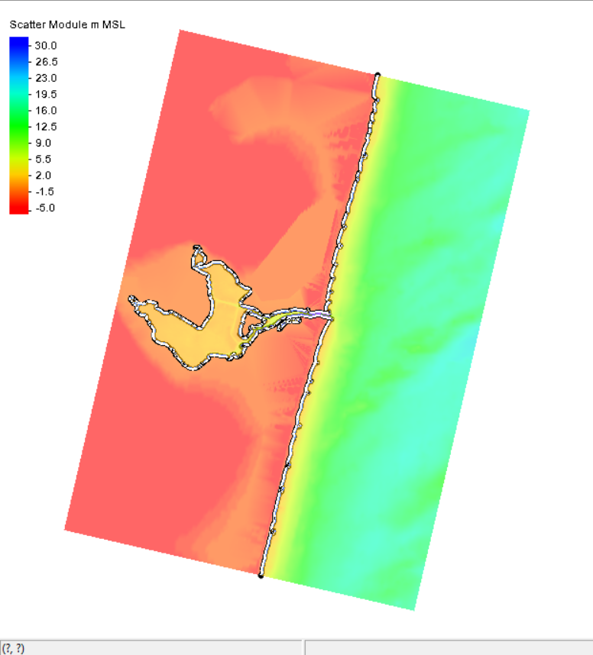
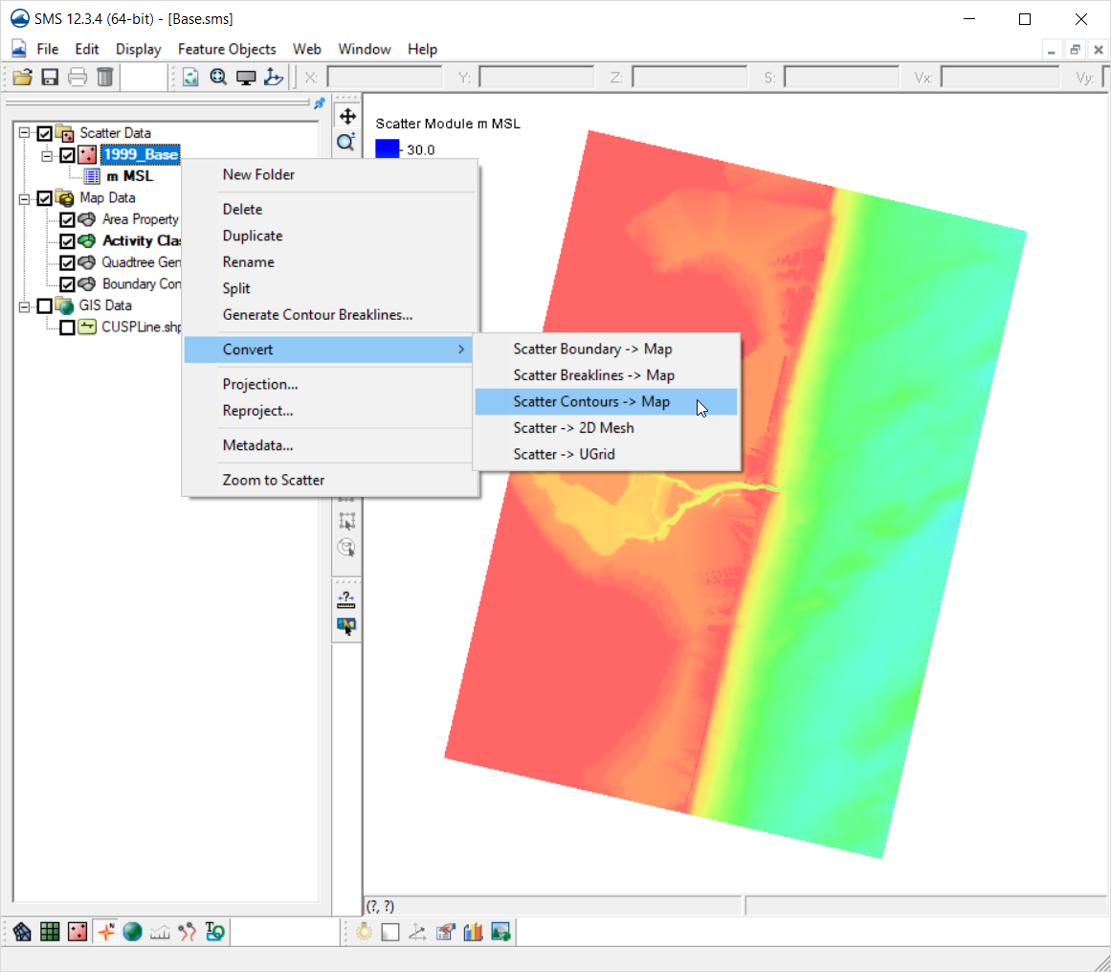
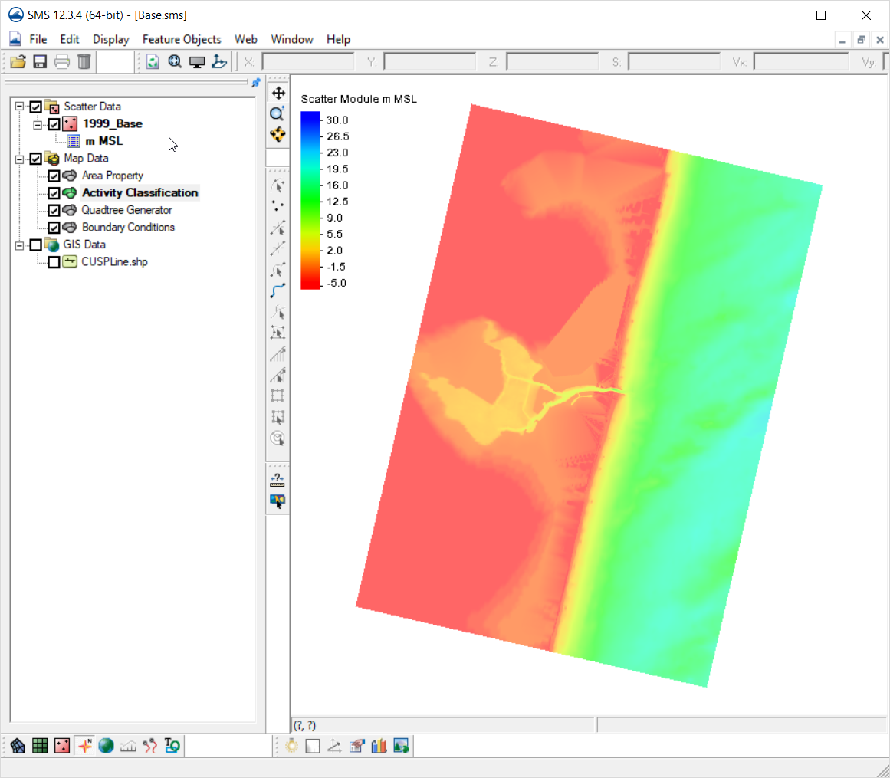
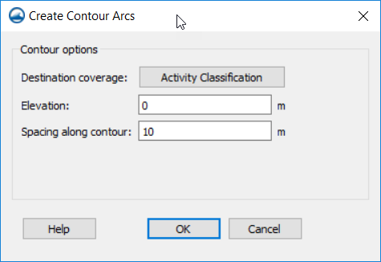
Next, we define the Land/Water interface with the Activity Classification coverage.
Click the Activity Classification coverage in the Data Tree
Right Click your final bathymetry dataset in the scatter module.
Choose “Convert | Scatter Contours → Map”
Destination coverage should be “Activity Classification”
Elevation = 0 m
Spacing = 10 m
Note: Using 0.0 is just an example. Realistically, you would consider the tidal range and other factors when determining the land/water interface.

Slide 9
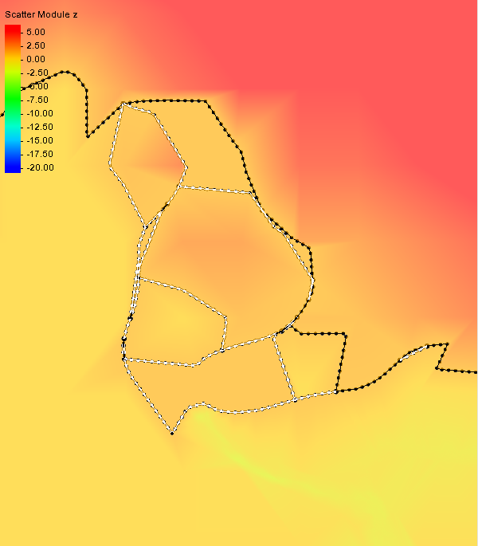
Usually after the previous steps, you will need to clean up excess feature arcs.
Click the Feature Arc selection tool.
Click the first arc you wish to remove, then click subsequent arcs while holding the Shift key down to multi-select and delete.
Continue for your entire domain area.
To pan your screen while selecting, hold the F2 key down and drag with your mouse, then release and keep selecting.

Slide 10
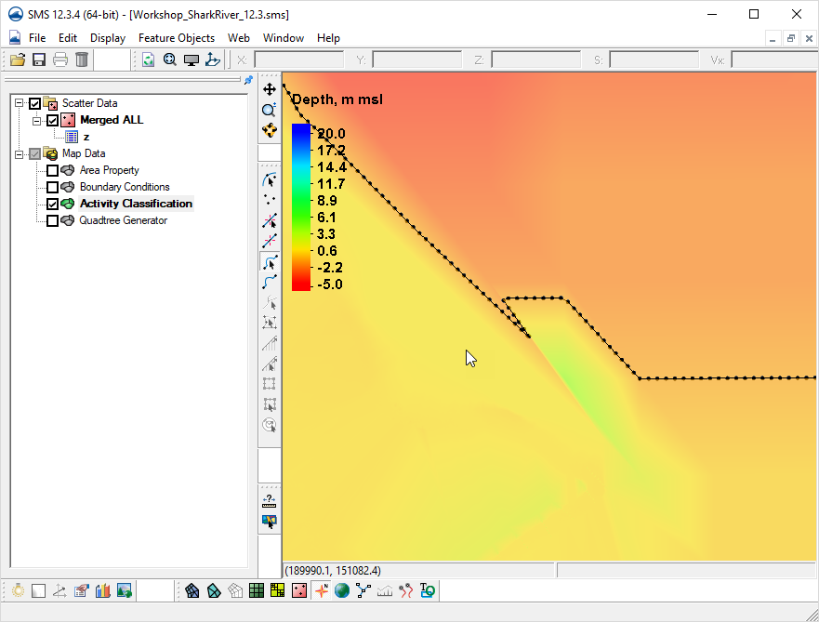
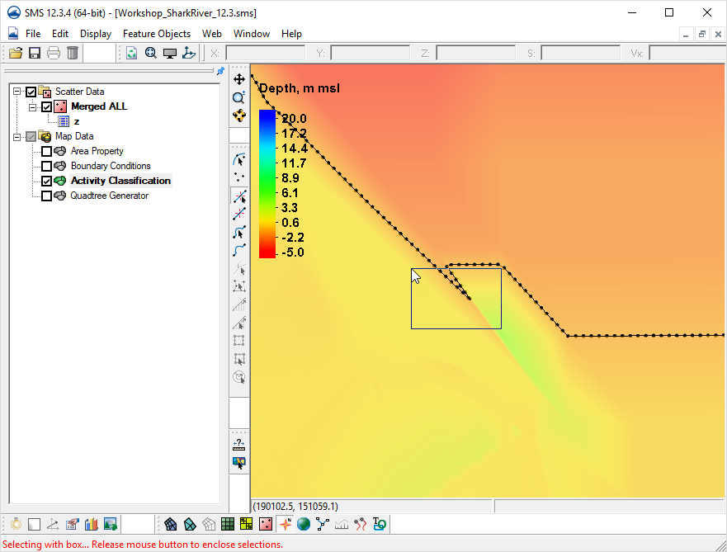
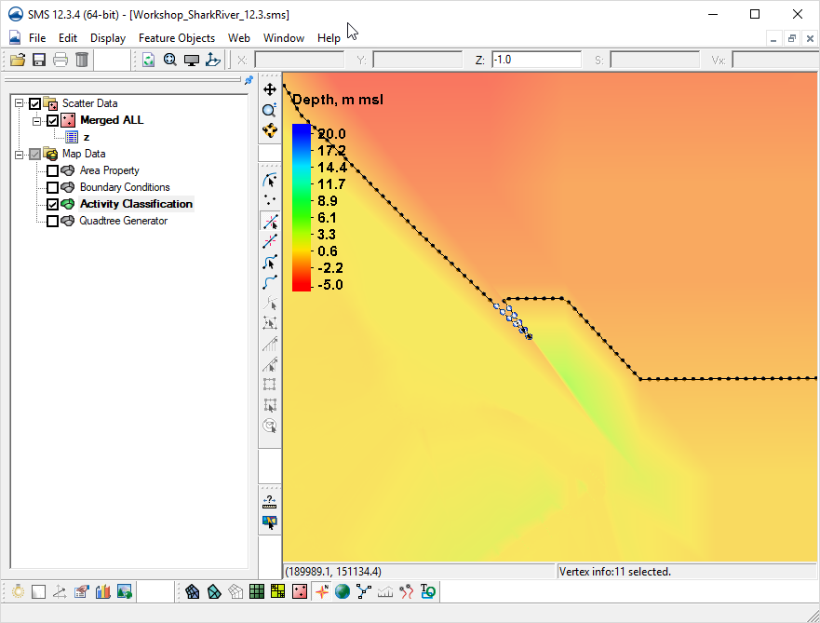

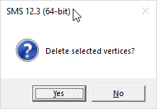
If you want to remove some sharp angles or other points from the boundary arc, select feature vertices with the tool.
Once selected, hit the delete key to simplify the feature arc.

Slide 11
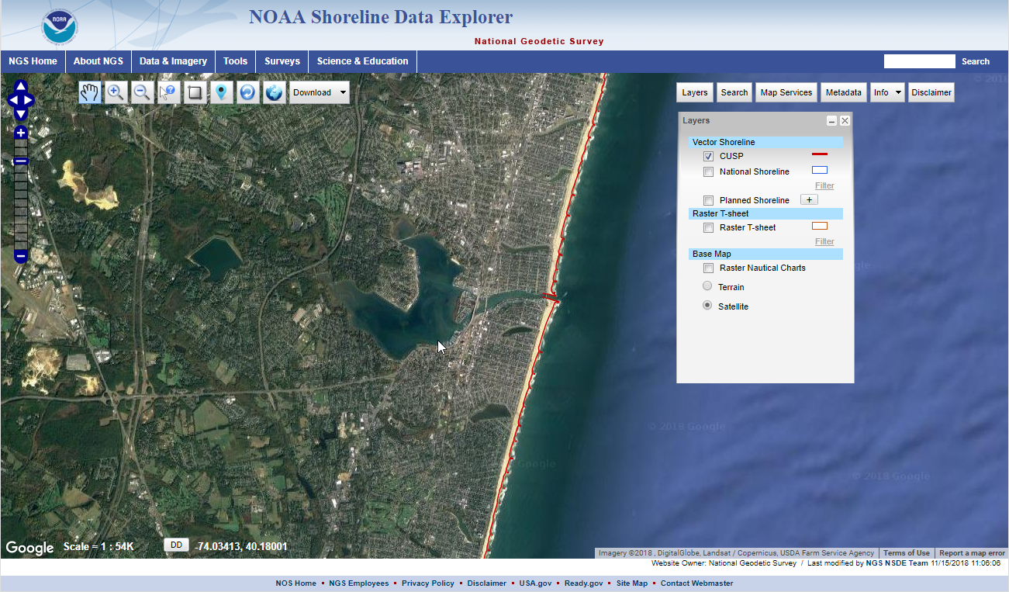
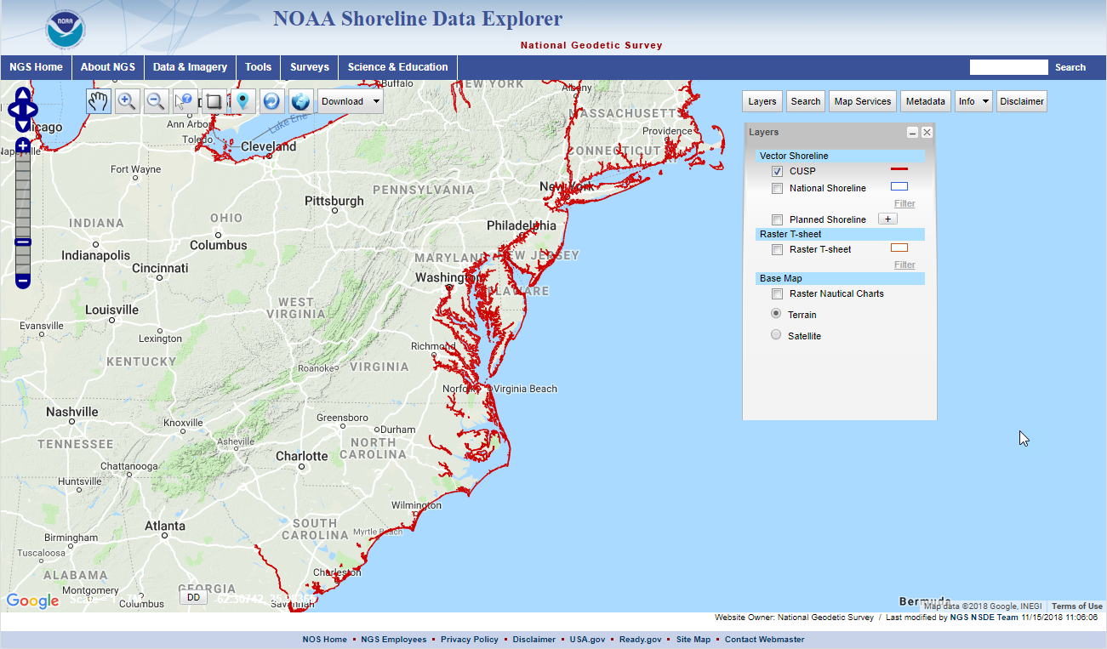
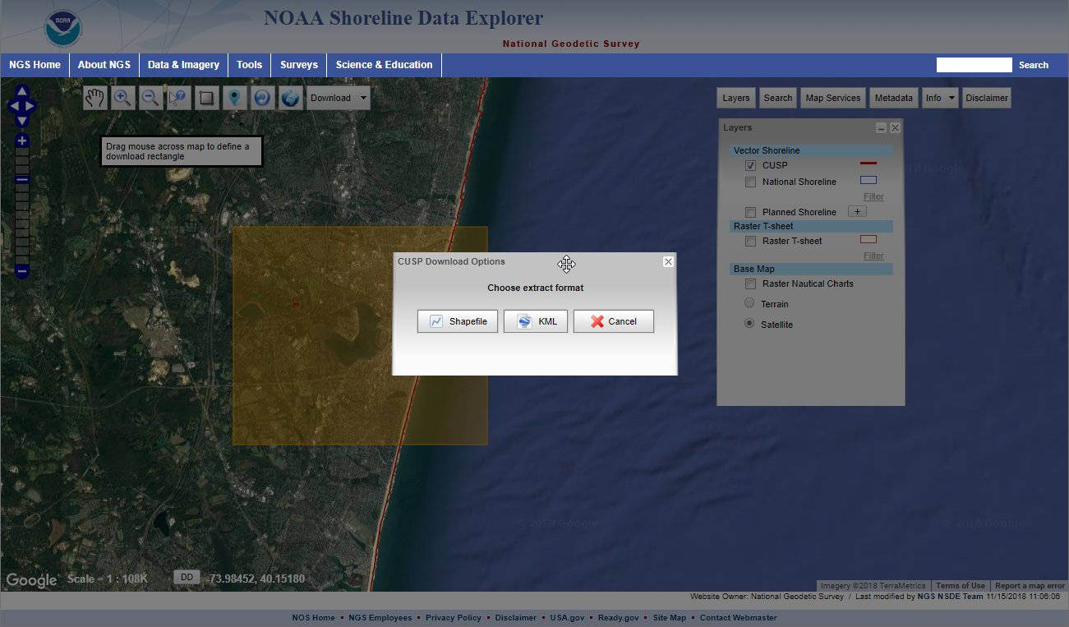
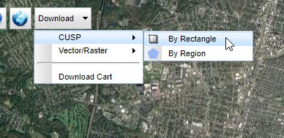
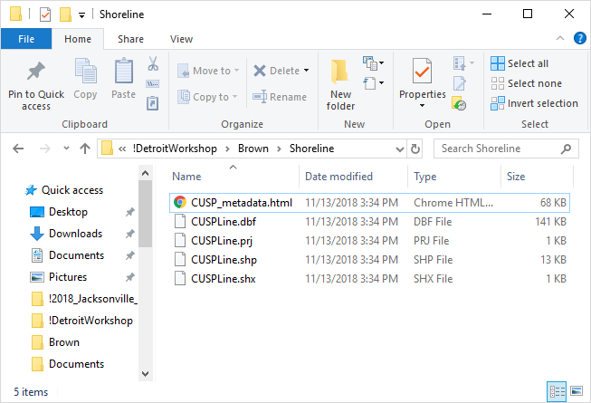
Additional way to bring in a shoreline from a Coastline database
Coastline database
https://shoreline.noaa.gov/data/datasheets/cusp.html. (one example)
The ArcGIS shape file can be directly loaded into SMS for part of the coastline arcs.

Slide 12
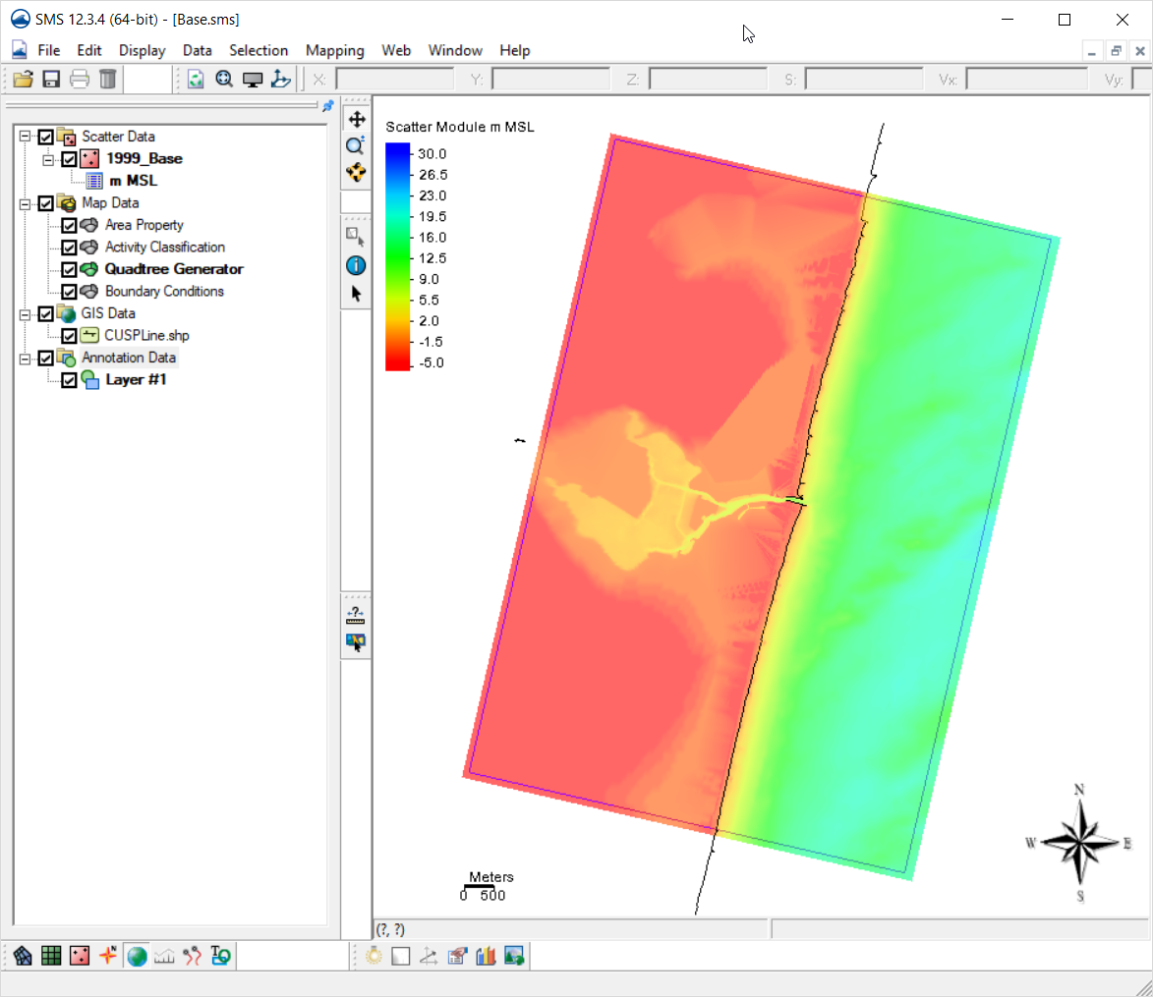
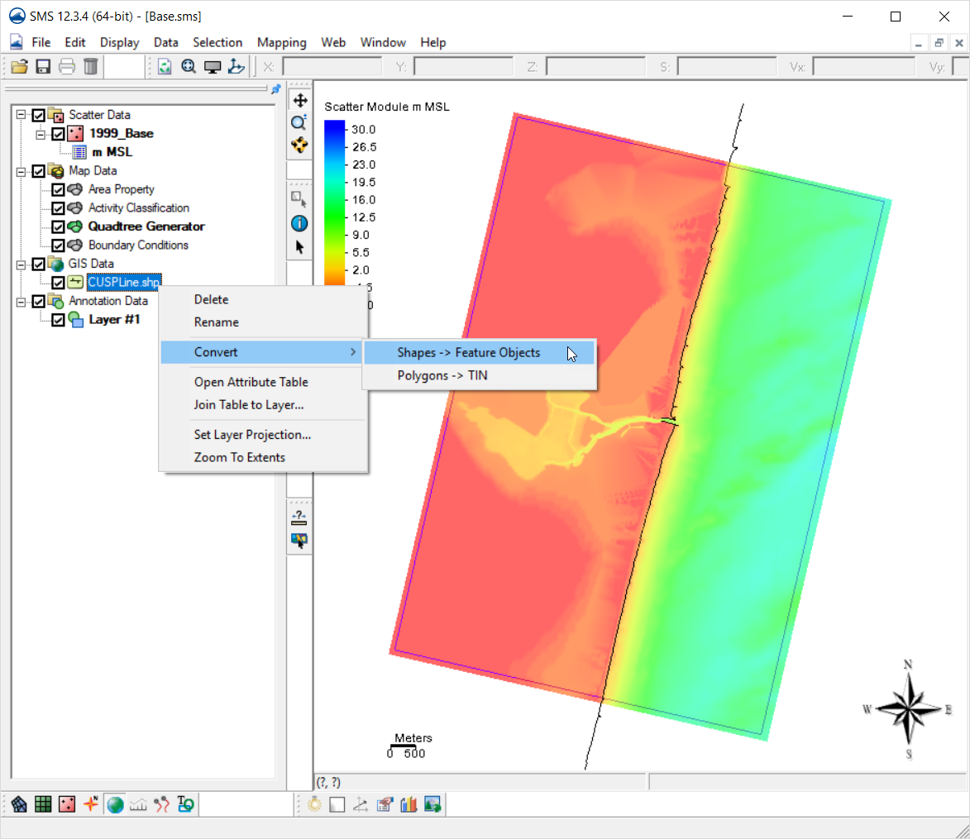
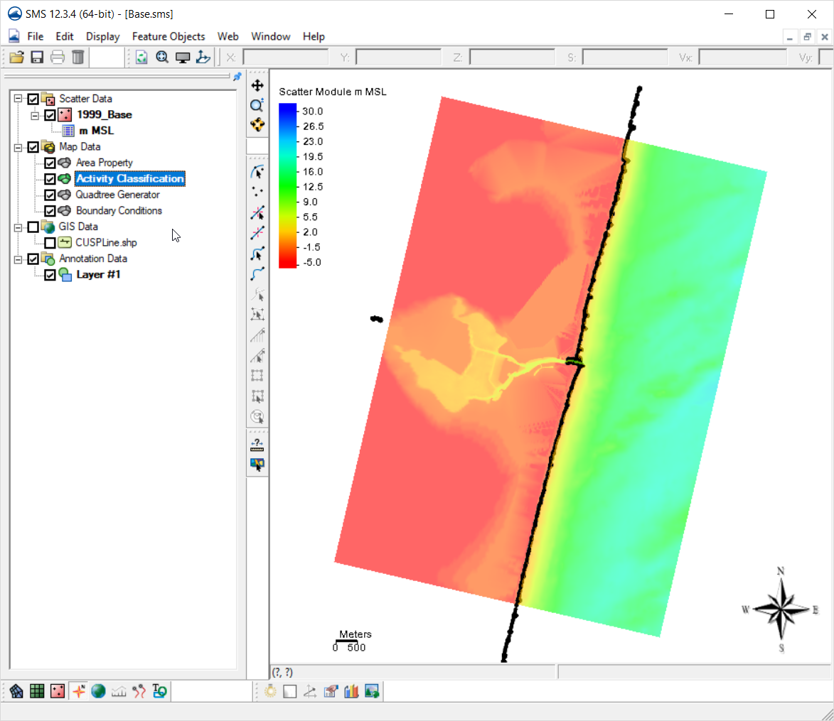
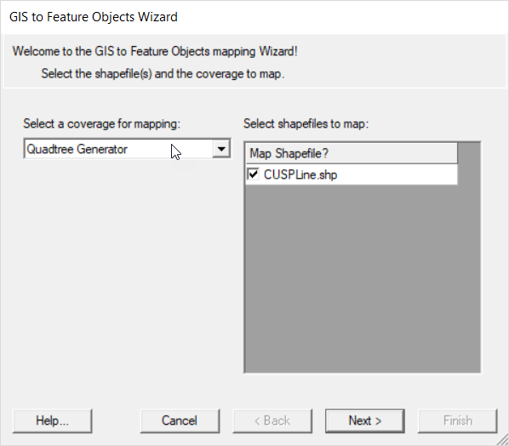
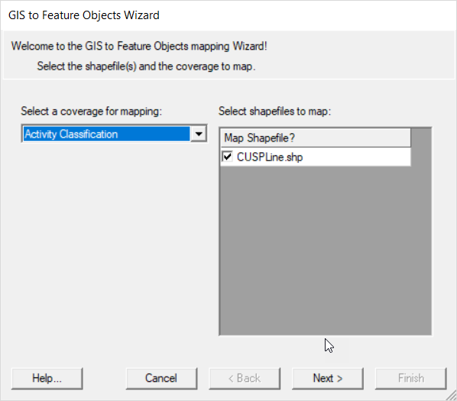
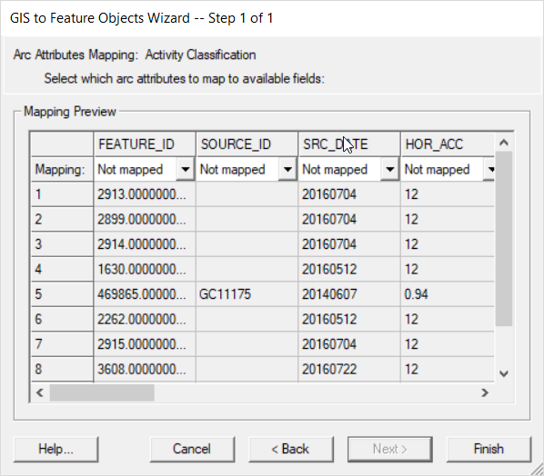
If you have an elevation dataset in the shape file to match with the coastline, it can be selected.
We will just click Finish
This is an older set of files without the full bay area. The files included in the HandsOn are complete.

Slide 13
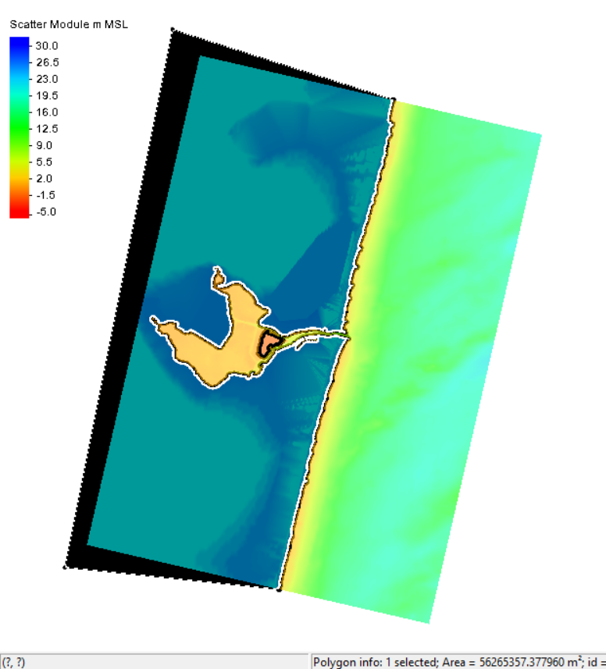
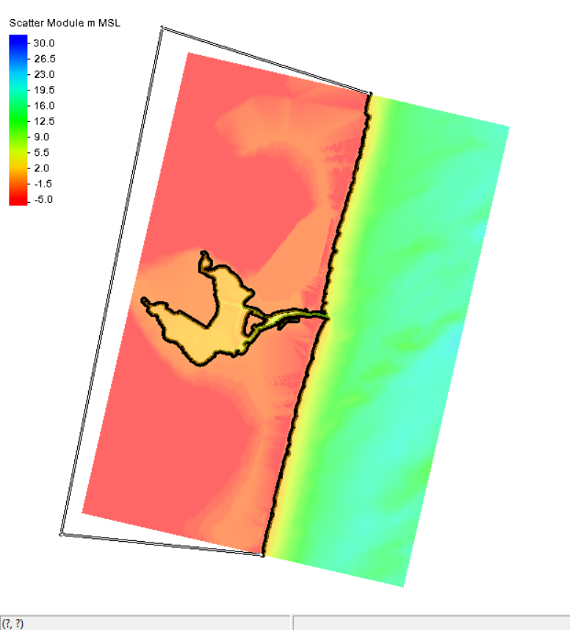
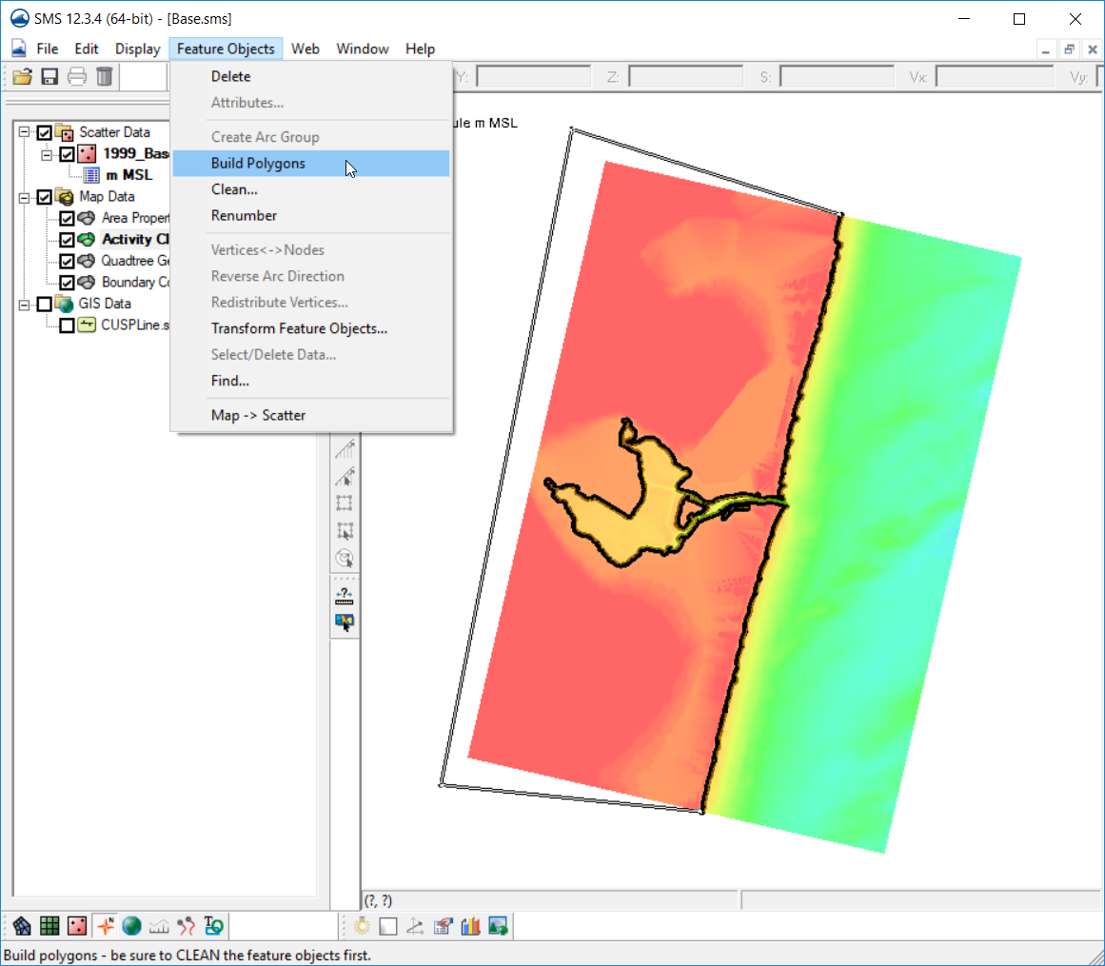
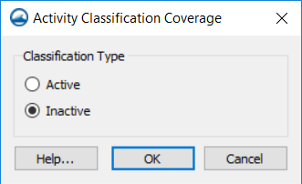
Create a polygon with coastlines to define the “land” (non-computational) area.
With the Activity Classification coverage selected and active.
Choose the Create arc tool and enclose the polygon using the existing end points of the coastline arc.
Choose “Feature Objects | Build Polygons”
Click the Select Polygon tool and click the land polygon.
Right-click, then choose “Attributes” and make sure Inactive is specified for a Land area.

Slide 14
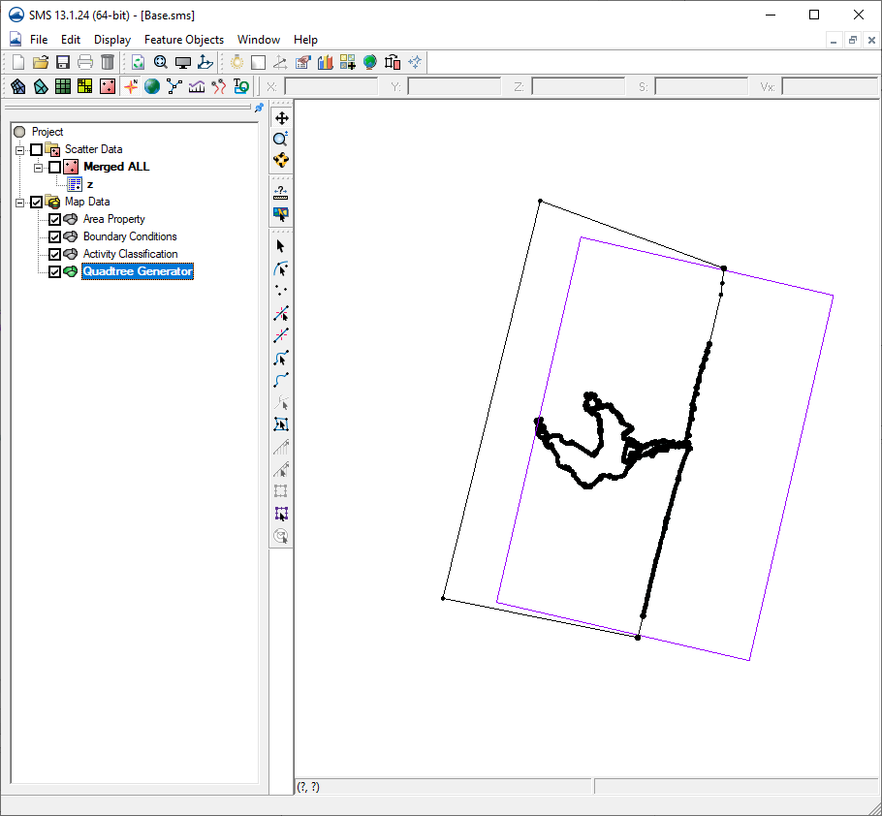
Nothing has to be exact right now.
All of this will show up better once the Quadtree or Cartesian grid has been constructed.
Be sure and save your project. This project has been saved in the “Workshop/Initial/Aftercoastline” Folder as “Base.sms” for use in future steps.

