Slide 1

Coastal Modeling System: Advanced Topics using CMS 5.3 and SMS 13.1 Multiple-sized Sediment Transport
Honghai Li, Mitchell Brown

Slide 2
Outline
Sediment transport in CMS
Equations
Parameters
Multiple-sized sediment transport calculation
Site
Transport grain sizes
Bed layering
Bed composition
Export CMS files

Slide 3
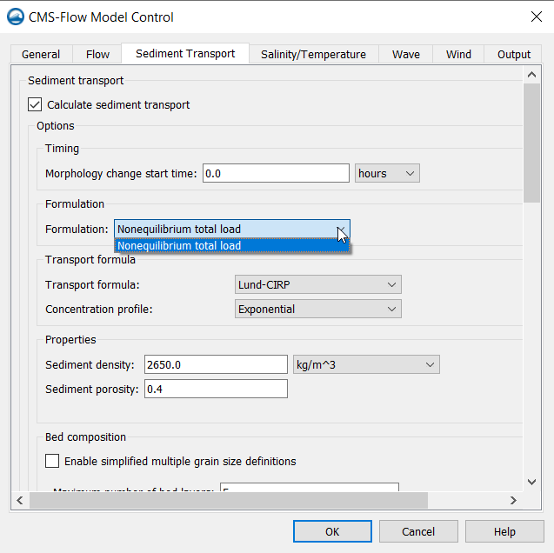
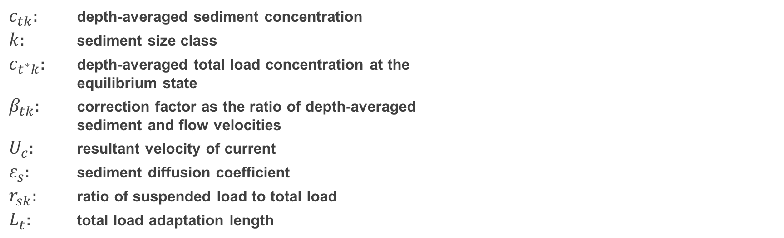
Sediment Transport in CMS (Non-equilibrium Transport, NET)
$$\frac{∂}{∂t}\left[\frac{DC_{tk}}{β_{tk}}\right]+\frac{\left.∂(DuC_{tk}\right)}{∂x}+\frac{\left.∂(DvC_{tk}\right)}{∂y}=\frac{∂}{∂x}\left[ε_{s}D\frac{∂\left(r_{sk}C_{tk}\right)}{∂x}\right]+\frac{∂}{∂y}\left[ε_{s}D\frac{∂\left(r_{sk}C_{tk}\right)}{∂y}\right]+\frac{U_{c}D}{L_{t}}\left(C_{t^{∗}k}−C_{tk}\right)$$
$c_{tk}$: depth-averaged sediment concentration
$k$: sediment size class
$c_{t^{∗}k}$: depth-averaged total load concentration at the equilibrium state
$β_{tk}$: correction factor as the ratio of depth-averaged sediment and flow velocities
$U_{c}$: resultant velocity of current
$ε_{s}$: sediment diffusion coefficient
$r_{sk}$: ratio of suspended load to total load
$L_{t}$: total load adaptation length

Slide 4
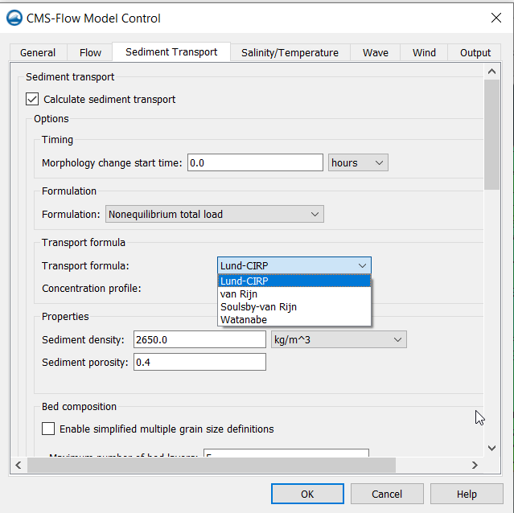
Sediment Transport Formulas (Non-equilibrium Transport, NET)
$$\frac{∂}{∂t}\left[\frac{DC_{tk}}{β_{tk}}\right]+\frac{\left.∂(DuC_{tk}\right)}{∂x}+\frac{\left.∂(DvC_{tk}\right)}{∂y}=\frac{∂}{∂x}\left[ε_{s}D\frac{∂\left(r_{sk}C_{tk}\right)}{∂x}\right]+\frac{∂}{∂y}\left[ε_{s}D\frac{∂\left(r_{sk}C_{tk}\right)}{∂y}\right]+\frac{U_{c}D}{L_{t}}\left(C_{t^{∗}k}−C_{tk}\right)$$
Sediment concentration and concentration capacity:
LUND-CIRP
VAN RIJN
SOULSBY-VAN RIJN
WATANABE
CSHORE

Slide 5
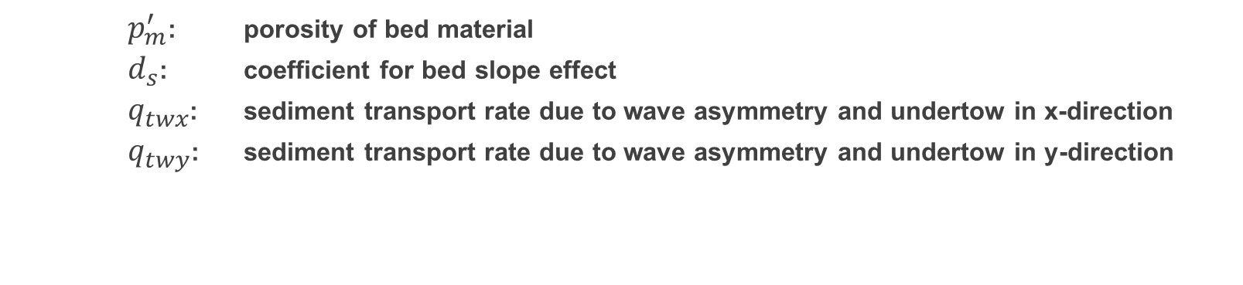
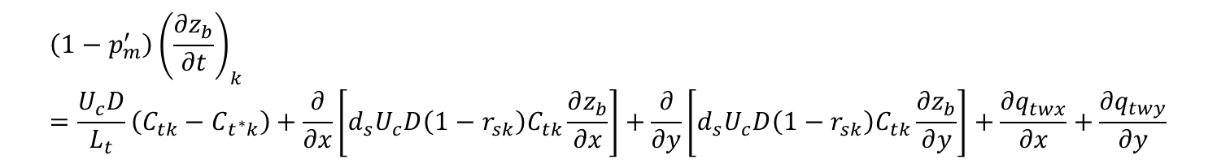
Bed Change
Bed change due to the k^{th} class of sediment:
$$\left(1−p_{m}^{′}\right){\left(\frac{∂z_{b}}{∂t}\right)}_{k}=\frac{U_{c}D}{L_{t}}\left(C_{tk}−C_{t^{∗}k}\right)+\frac{∂}{∂x}\left[d_{s}U_{c}D\left(1−r_{sk}\right)C_{tk}\frac{∂z_{b}}{∂x}\right]+\frac{∂}{∂y}\left[d_{s}U_{c}D\left(1−r_{sk}\right)C_{tk}\frac{∂z_{b}}{∂y}\right]+\frac{∂q_{twx}}{∂x}+\frac{∂q_{twy}}{∂y}$$
$p_{m}^{′}$: porosity of bed material
$d_{s}$: coefficient for bed slope effect
$q_{twx}$: sediment transport rate due to wave asymmetry and undertow in x-direction
$q_{twy}$: sediment transport rate due to wave asymmetry and undertow in y-direction

Slide 6
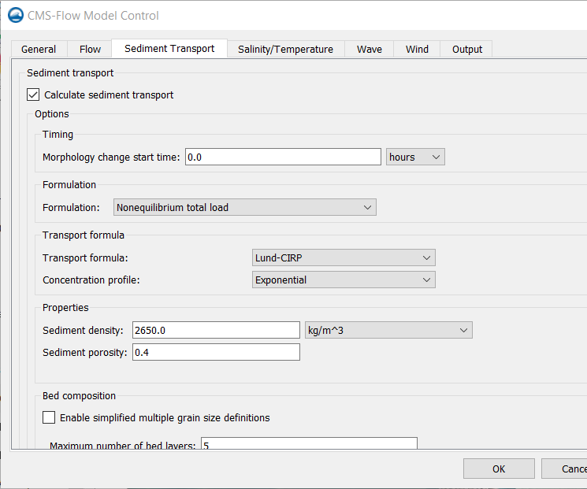
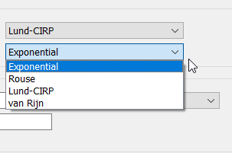
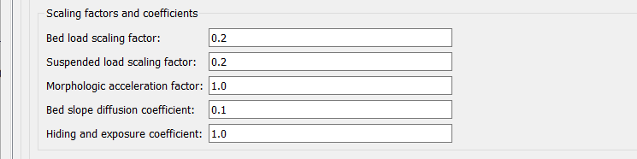
Sediment Transport Calculation
(Parameters)
Activate sediment transport calculation
Time to start the calculation of morphology change
Sediment transport models: non-equilibrium total load
Sediment transport formulas and concentration profile
Sediment density and porosity
Transport scaling factors, morphologic acceleration factor, bed slope coefficient (0-5), and hiding and exposure coefficient (0.1-1)

Slide 7
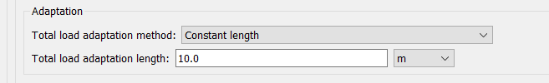
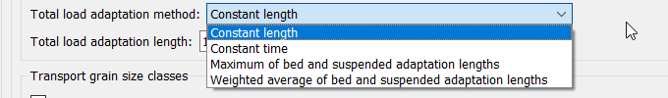
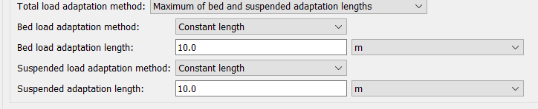
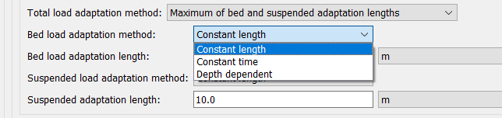
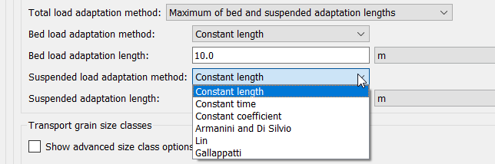
Sediment Transport Calculation
(Adaptation Coefficient)
Adaptation coefficient (method and length)
Adaptation method
Bed and suspended adaptation lengths
Bed load adaptation method
Suspended load adaptation method

Slide 8
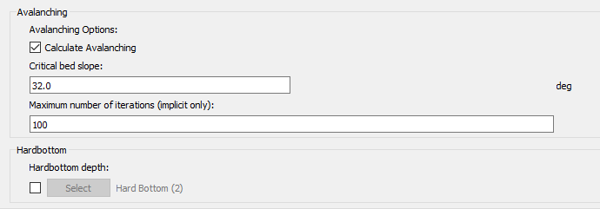
Sediment Transport Calculation
(Avalanching and Hard Bottom)
Avalanching
Angle of repose

Slide 9
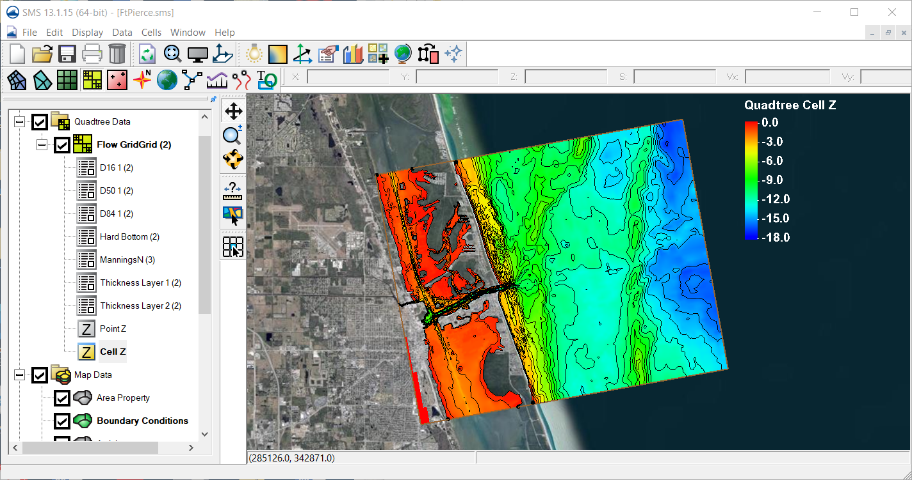
Multiple-sized Sediment Transport Calculation
(Ft. Pierce, Florida)

Slide 10
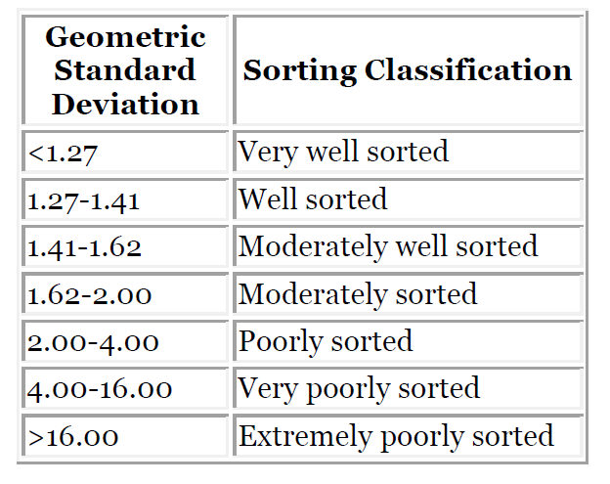
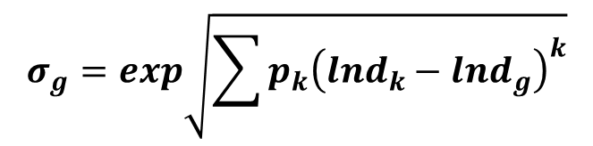
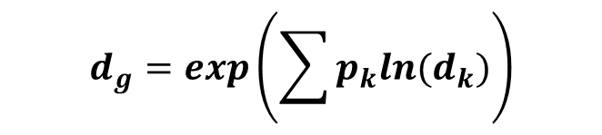

Multiple-sized Sediment Transport Calculation
Geometric Standard Deviation
$$σ_{g}=exp\sqrt{\sum{{p_{k}\left(lnd_{k}−lnd_{g}\right)}^{k}}}$$
$p_{k}$: fraction
$d_{k}\text{: }\text{size} \text{class} \text{diameter}$
$d_{g}$: geometric mean
$$d_{g}=exp\left(\sum{p_{k}ln{(d}_{k})}\right)$$
Geometric Standard Deviation greater than approximate 1.41 should be simulated with multiple grain sizes

Slide 11
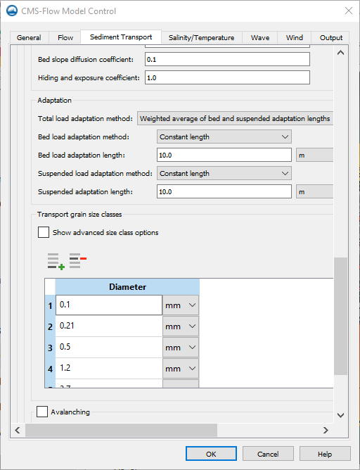
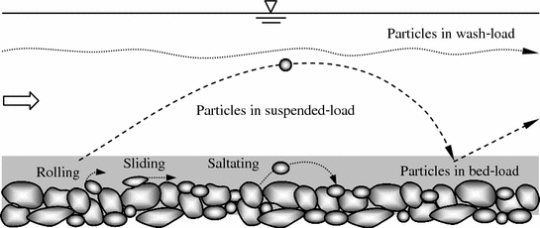
Multiple-sized Sediment Transport Calculation
(Transport Grain Sizes)
Transport Grain Sizes
Transported sediment material is discretized into different groups each representing the sediments within a specific size range
These groups are referred to as sediment size classes and have the following properties
Characteristic diameter
Fall velocity
Corey shape factor
Critical shear stress

Slide 12
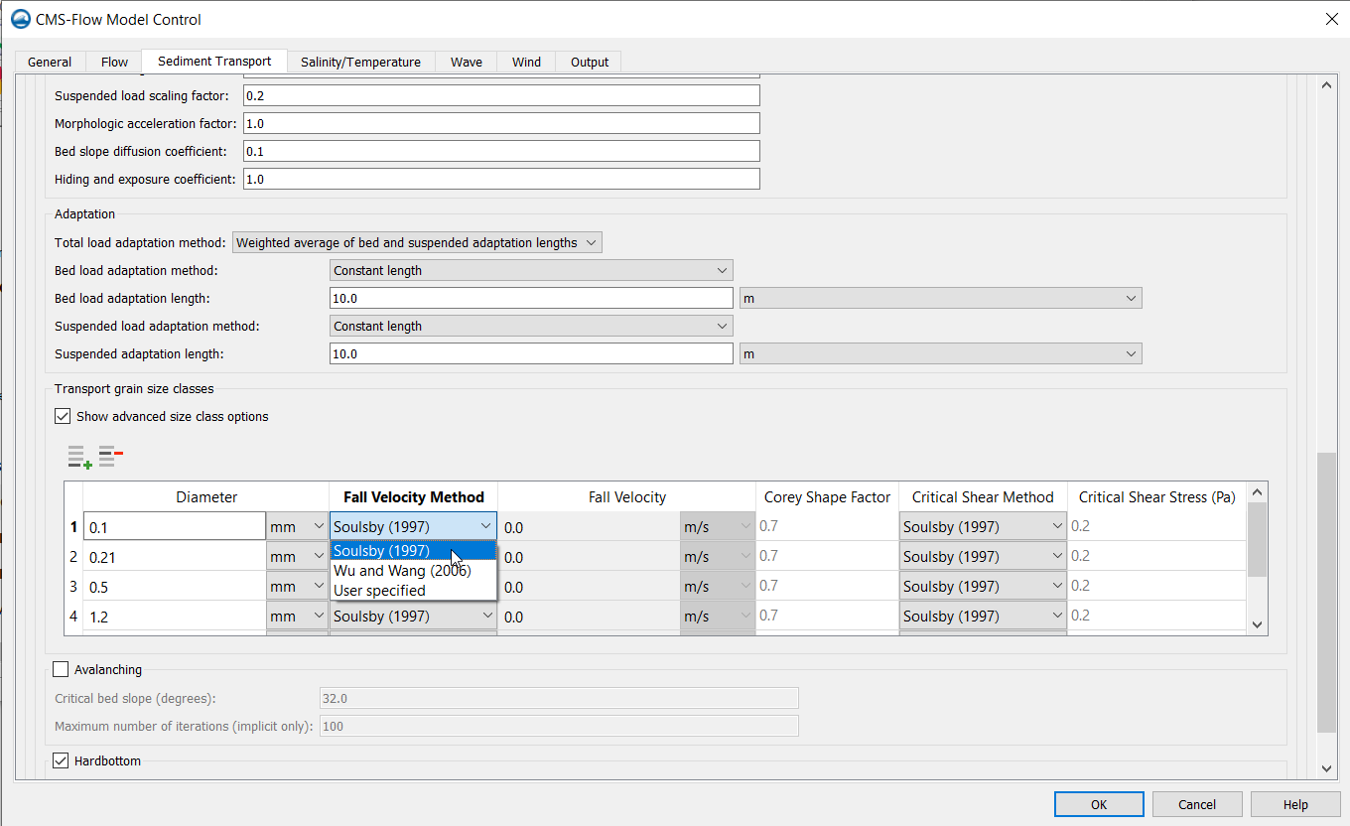

Multiple-sized Sediment Transport Calculation
(Transport Grain Sizes)
Transport Grain Sizes
Characteristic diameter
Related to the lower $d_{k−1/2}$ and upper $d_{k+1/2}$ bin limits by
$$d_{k}=\sqrt{d_{k−1/2}d_{k+1/2}}$$
Estimate the grain size classes based only on the size limits of the distribution
$$d_{k}=exp\left[lnd_{1}+ln\left({d_{N}/d}_{1}\right)\frac{k−1}{N−1}\right]$$
Fall velocity
Soulsby (1997)
Wu and Wang (2006)
User-specified
Corey shape factor
Used in Wu and Wang (2006)
Critical shear stress
Soulsby (1997)
Wu and Wang (1999)
User-specified

Slide 13
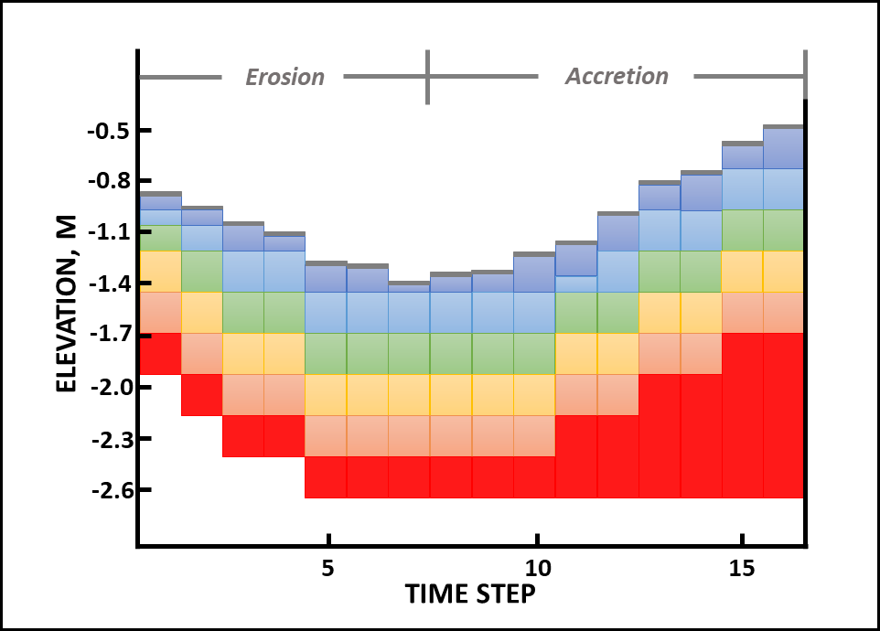
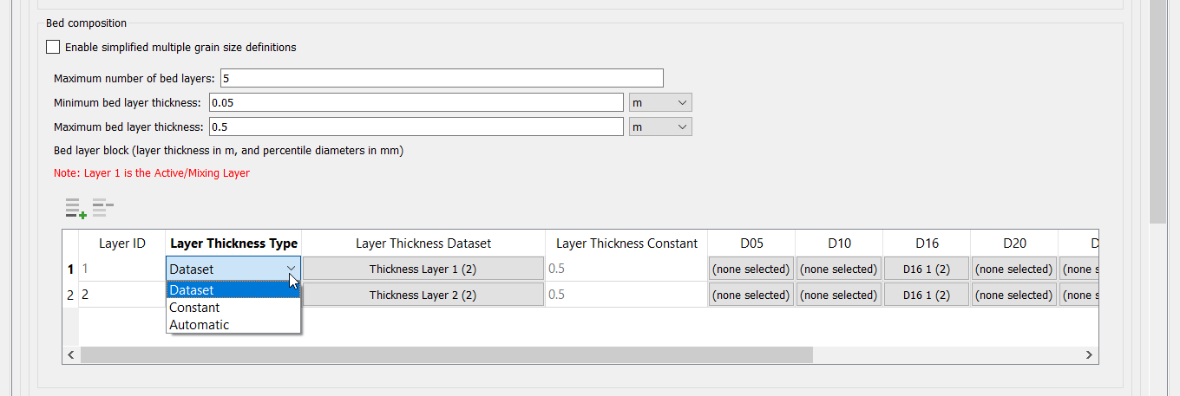
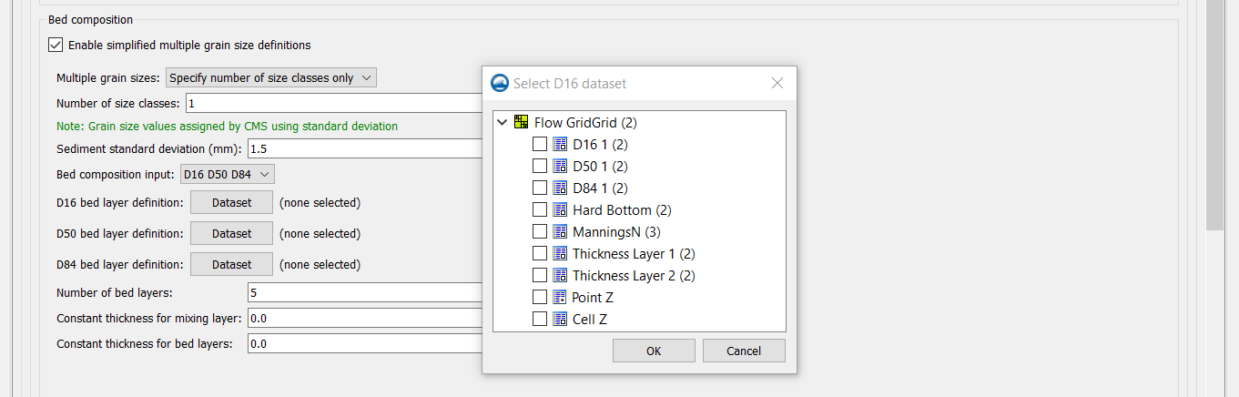
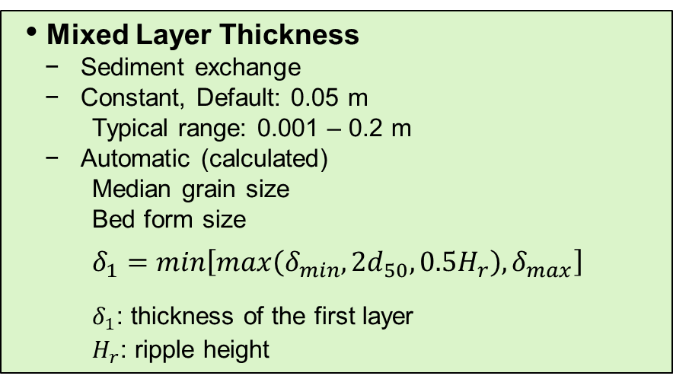
Multiple-sized Sediment Transport Calculation
(Bed Discretization)
Mixed Layer Thickness
Sediment exchange
Constant, Default: 0.05 m
Typical range: 0.001 – 0.2 m
Automatic (calculated)
Median grain size
Bed form size
$$δ_{1}=min\left[max\left(δ_{min}, 2d_{50},0.5H_{r}\right),δ_{max}\right]$$
$δ_{1}$: thickness of the first layer
$H_{r}$: ripple height
Lower Layers
Specified
Copied from the layer above
Constant
Spatially varying (dataset)

Slide 14
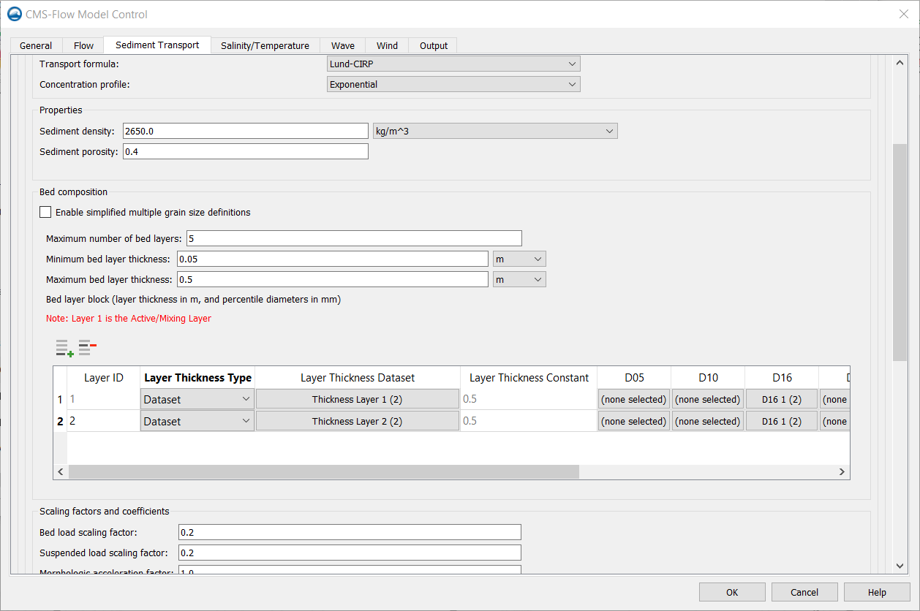
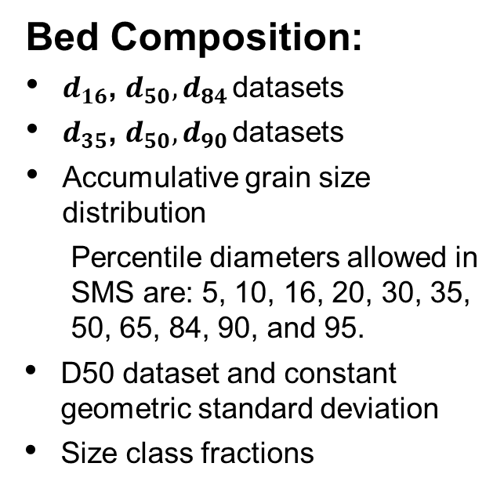
Multiple-sized Sediment Transport Calculation
(Bed Composition)
Bed Composition:
$d_{16}$, $d_{50},d_{84 }$datasets
$d_{35}$, $d_{50},d_{90 }$datasets
Accumulative grain size distribution
Percentile diameters allowed in SMS are: 5, 10, 16, 20, 30, 35, 50, 65, 84, 90, and 95.
D50 dataset and constant geometric standard deviation
Size class fractions

Slide 15
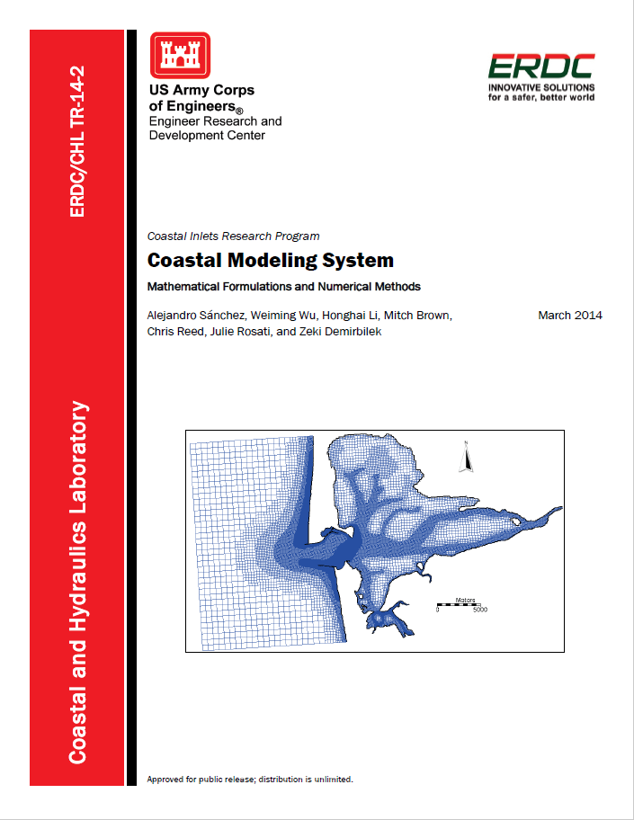
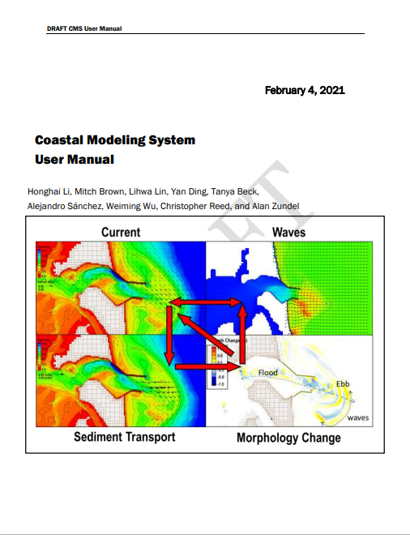
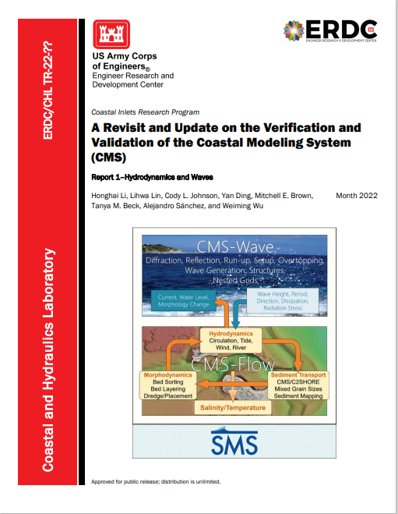
References
Coastal Modeling System: Mathematical Formulations and Numerical Methods
https://apps.dtic.mil/dtic/tr/fulltext/u2/a598297.pdf
Coastal Modeling System User Manual
(Draft Tech Report)
A Revisit and Update on the Verification and Validation of the Coastal Modeling System
(Draft Tech Report)

